Slide 1




Stock Market Data Analysis
Team Members:
Saikiran
Manjit
Siddesh
Yogendra
Vignesh

Slide 2

Project Contents:
Business Objectives
Data Analysis and Visualizations
Feature Engineering with Visualizations
Feature Selection
Model Training and Finalizing the Best Model
Obtaining Predictions/Scoring
Model Deployment

Slide 3

Business Objective:
Stock Market Data Analysis of National Stock Exchange (NSE)
The aim of this project is to build a Machine Learning Model to Predict the Close Price of Stocks based on different explanatory variables describing aspects of Stock trends.
Why is it important? Companies/Investors wants to invest in those stocks which will have More Profits. They try to purchase stocks with low amount and expect High Profit. So, At what couple of day what is the Stock value to Help the investor, he/she able to purchase those stocks.
Objective:
In today’s world companies and businesses are very keen to understand and analyse the market to lower their expenses and enhance profits.
With modern data analytics, we can identify purchasing and selling patterns by carefully analysing the data to help the investors
3

Slide 4


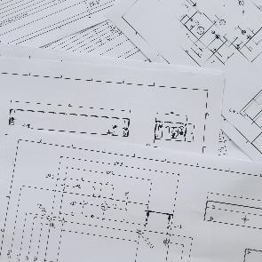


Data Analysis and Visualizations:
DataSet Details and Collection:
We have Tried with different data sources library that were available within python.
Libraries such as NSEPY, YahooFinance, pandas-datareader etc
We finalized to collect the data from YahooFinance for Model Deployment.
Reason: Since all the Libraries give exact sam values for the stocks as experimented . We came to conclusion that YahooFinance library will be proper fit for the process.
As per the information from internet :Below are the Top 4 “IT Services & Consulting” Companies DataSets we imported from NSEPY library for Data Analysis
TCS, TATA-MOTORS, INFOSYS, WIPRO.
In Model Deployment we used Tatamotors and Line data from YahooFinance
2
4
6
4

Slide 5
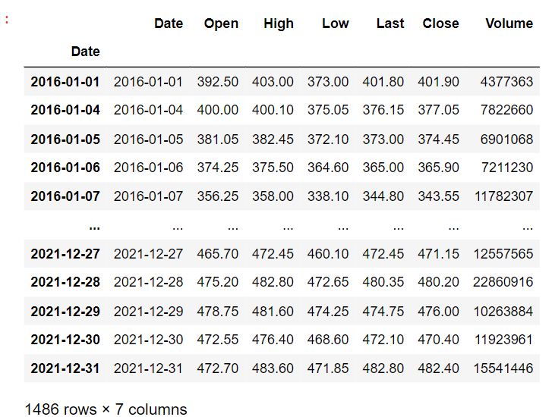
Getting the Data:We get our data from NSEPY for the last 5 years. For each stock, we import data separately.
Data Description: About the Variables Information
Target Variable is “Close”
Sample“TCS” Stock DataSet (2016-2021)
Open: The price of the stock when the market opens in the morning.
Close: The price of the stock when the market closed in the evening for the day(last buy-sell orders executed between 2 traders).
High: Highest price the stock reached during that day.
Low: Lowest price the stock is traded on that day.
Volume: The total amount of stocks traded on that day (Total amount of Trading/Shares activity during that day/a period of Time).
Last: The Corrected price of the stock when the market closed in the evening for the day.
Total Rows in all Stocks = 1486
Number of Variables/Columns = 7
5

Slide 6
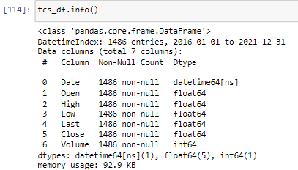
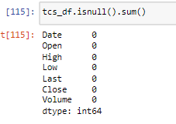
We Checked for the: 1. The target variable (Close) 2. Variable Data Types 3. Missing data (No-Missing Data) 4. Numerical variables
6

Slide 7
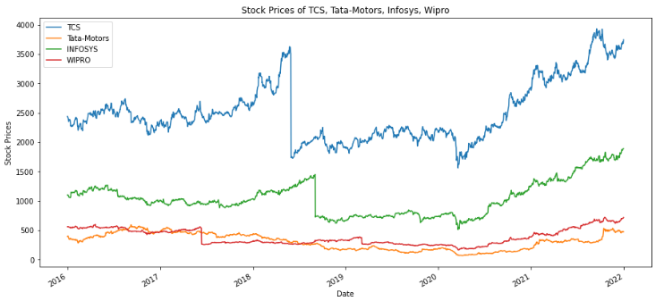
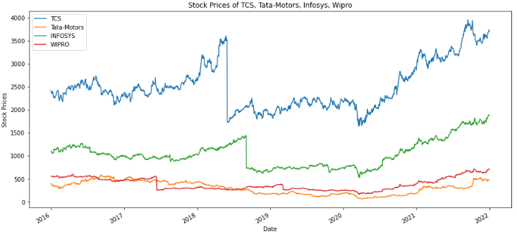
Data Visualizations: Charts and Graphs
OPEN:
CLOSE:
This is the Normal Line Plots of all the Stocks, We can see the Trend is Upward with mutliplicative seasonality (No Constant Ups and Downs through out the Year of the Stocks).
**As we see in graphs of open and close stocks, we see that TCS has taking many up and downs almost the whole journey.
It start from around 2450 points and faced major down fall but at last it reached higher to 3700 points.**
We have Irregular/ Random/ Noise Component, Due to Random variation or unforseen events
We Get a Proper Visual for TCS stock! But the rest of the Stocks are not showing proper trend, We will Try to Visualize the trend in depth further.
7
7

Slide 8
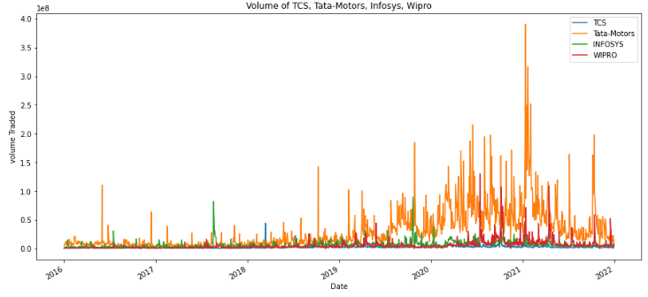
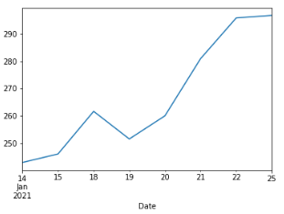
Graph Trends Continued..
By using .argmax()
for Date and position
And found this is where on “2021-01-12” There was a Huge Spike of Tata-Motors Volume trade happened
VOLUME Traded of All the Stocks in One PLOT
Here, in Volume you can see Tata-Motors has a very Big Spike between around 2021 jan to Mar
Now you can see above clearly for the Open Stock Price Also Went up during 2021-01-12.
You can see above the Volume of Tata-motors huge spike in 2021-01-12.
8

Slide 9
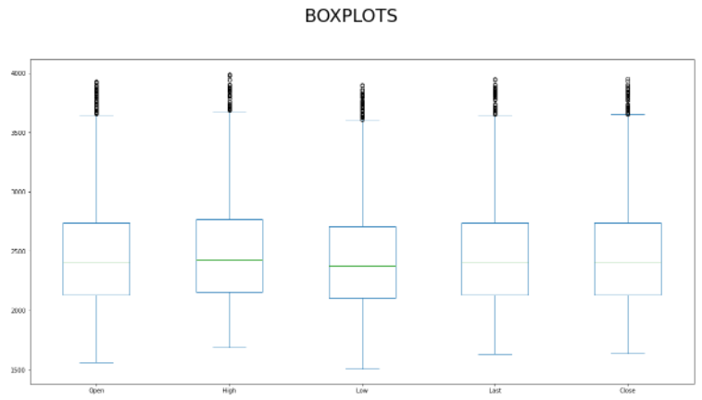
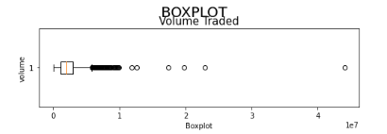
BOXPLOTS: For all the Variables for “TCS” Stock:
VOLUME
Open High Low last Close
From this Boxplots we can infer that there are Outliers in all the Columns that we need to Consider into account
Any Point beyond Upper Limit or Lower than the Lower Limit is considered as outliers.
Any Point beyond Upper Limit or Lower than the Lower Limit is considered as outliers.
9
9

Slide 10
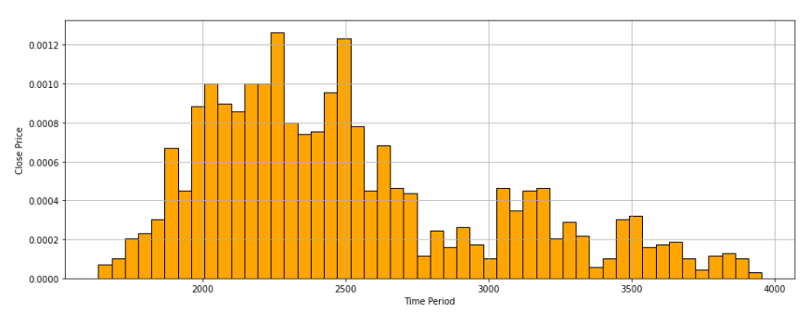
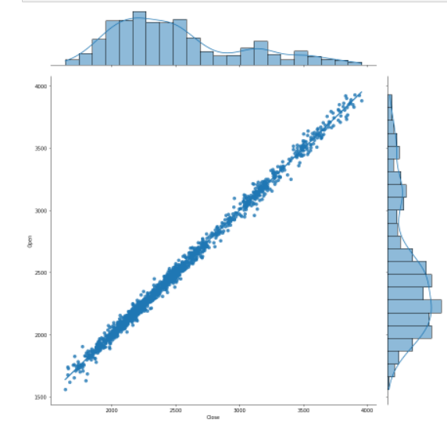
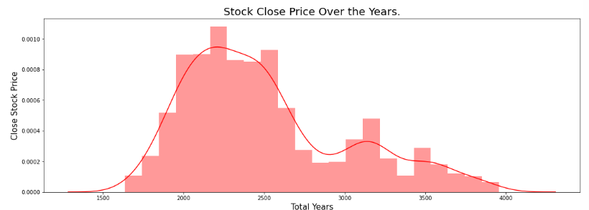
Graphs continued: Visualizing Histogram and Density Plot of TCS “Close” Price
JOINT
PLOT:
Close
vs
Open
Form this Plot we can Infer that the Close and Open Variable of TCS is Positively Skewed.
##Positive skewed : It indicates that the tail is on the right; the mass of the distribution is concentrated on the left of the figure.
10

Slide 11
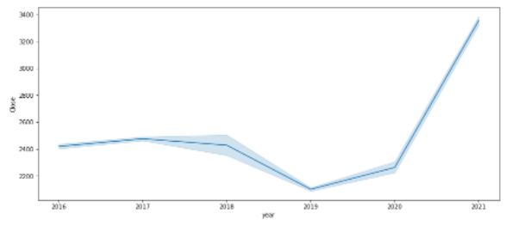
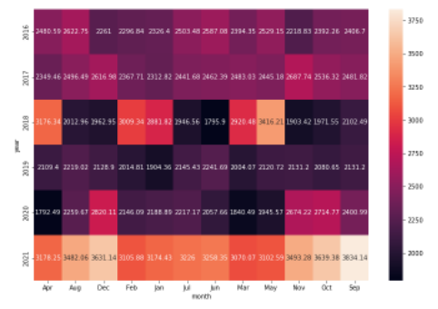
Visualizations continued with Feature Engineering:
Here we Introduced Two Variables “Month” and “Year” from Date Column using (.dt.strftime("%b / %Y")) method.
This line Plot is for TCS: Year vs Close
What is that light blue margin? Its a ‘95% confidence Interval'
#Passing the entire dataset in long-form mode will aggregate over repeated values (each year) to show the mean and 95% confidence interval:
This Heatmap if for TCS “ Month vs Year
Here on the Scale you can see :the Darker the color the lesser the Close Stock Price and vice versa
11

Slide 12
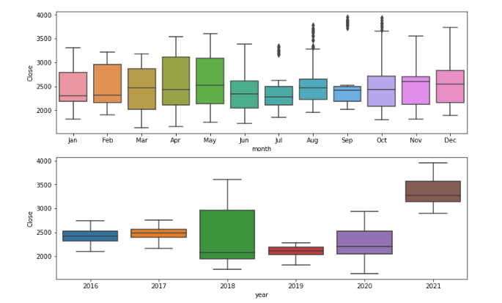
Type of Down-Sampled Box-Plots of newly introduced Month and Year variable.
Plots of TCS Month,Year vs Close
Here, we can see the median of all the Months through the Year from 2016 till 2021
and Median of all Years
We can see the effect when we try to Down-Sample from Days to Months and Years)
12

Slide 13
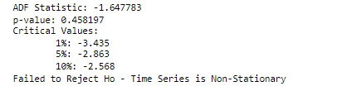
Feature Engineering: Dickey Fuller Test (ADF)
We use Statistical Methods like “Dickey Fuller Test” to check the DataSet Stationarity
The Augmented Dickey Fuller Test (ADF) is unit root test for stationarity.
It checks if your time series is stationary or not.
A stationary time series is one whose statistical properties such as mean, variance, autocorrelation, are all constant over time. Such statistics are useful as descriptors of future behaviour only if the series is stationary.
The hypothesis for the test:
The null hypothesis for this test is that the time series is non-stationary.
The alternate hypothesis for this test is that the time series is stationary.
13

Slide 14
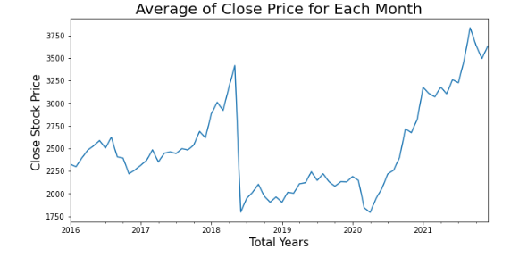
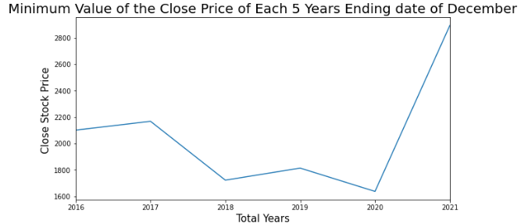
Down Sampling: Days to Each Months using .resample()
Down Sampling: When you Want to move from high frequency to low Frequency we will go for “Averaging method” {eg Days to Month} Here we need to Decrease (Average) the Samples to go to Low frequency {from High frequency to Low frequency we need to go} ZOOM OUT (We average all the 24 hours dp and we get One dp which is 1 Day Temp.
resample = tcs_df.resample('M’) //M: Month Wise(avg of 30 Days as 1 Month value) ; Q : Quarter(3 Months avg) end frequency
Monthly_values = resample.mean() //Created a new variable “Monthly Values & stored all variables in that for visualization
# Here we can see the Month end wise Closing Prices of Entire Period
#Upward Exponential trend
14

Slide 15
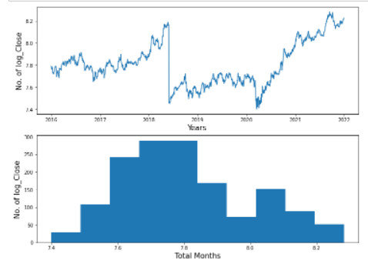
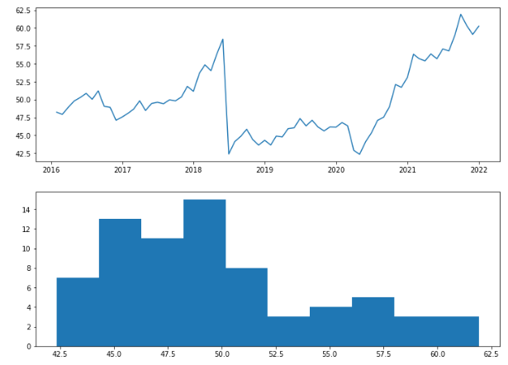
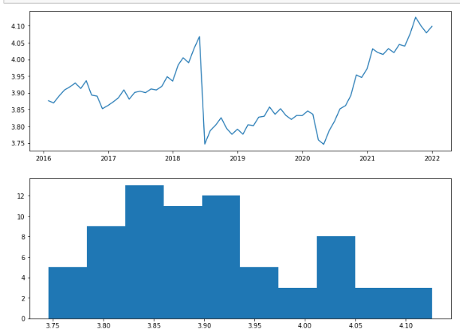
Converting Non-Stationary to Stationary
So, sometimes if you want to remove the Noise/to improve the Signals in Forecasting we will have to go for the Transformation Methods (To convert Non-Linear data to Linear Data) So, we have different-different transformation, Some few Popular Transformations
We used this technique on Down Sampled Data (Months)
1) Square Root 2) Log Transformation
Log transformation for entire TCS dataset for all days for Close Column
15

Slide 16
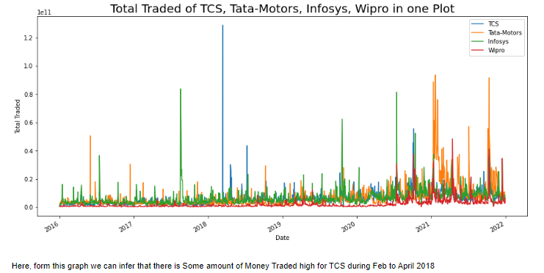
Feature Engineering and Feature Selection
Market Cap: ""Total Traded" *For All Stocks“
"Total Traded" = 'Open price' * 'Volume'
We don't have any information giving us a more precise explanation of what kind of company, might be more valuable than the other so our current data doesn’t have that information of total units of stock present.
What we can do over here is just a simple calculation to try to represent "Total Money Traded" so we are going to be using the Open price for that and the Volume, so what’s the Current Stock price and the Volume Traded, so we can do a small calculation to try to represent Total Money Traded
Defined a new column for each of the stocks by calling it as "Total Traded" = which is nothing other than the 'Open price' multiplied by the 'Volume'.
# To, Find the MAX Spike Date happened for TCS we use argmax() for Date and position
Continued Next Slide
16

Slide 17
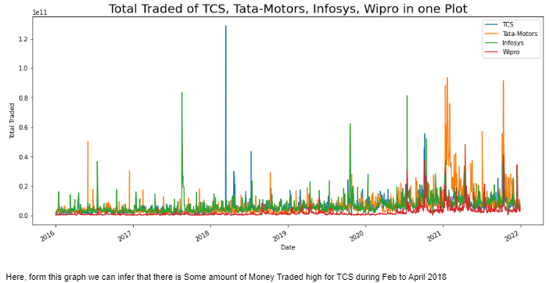
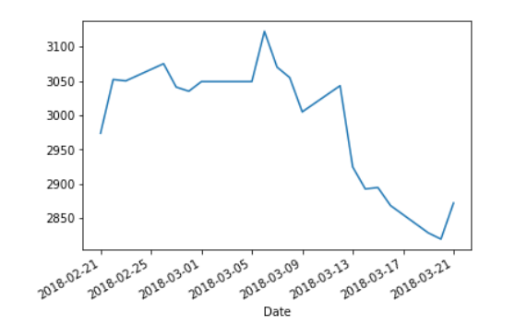
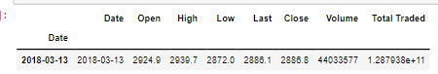
# To, Find the MAX Spike Date happened for TCS we use argmax() for Date and position
So this is where on 2018-03-13 -> There was a Huge Spike of tcs_df 'Total Traded' happened.
Here you can see The volume of tcs_df Went Up in 2021-01-12 , and here the Open Stock Price Also Wend up
17

Slide 18
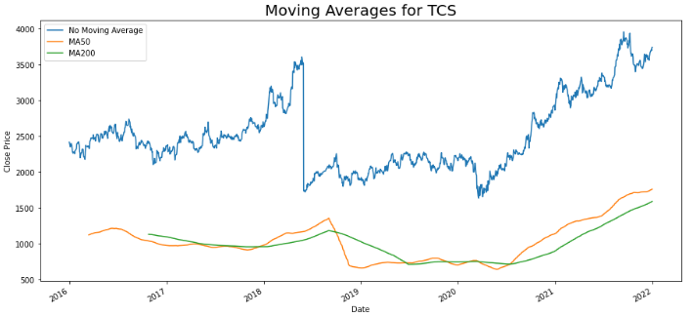
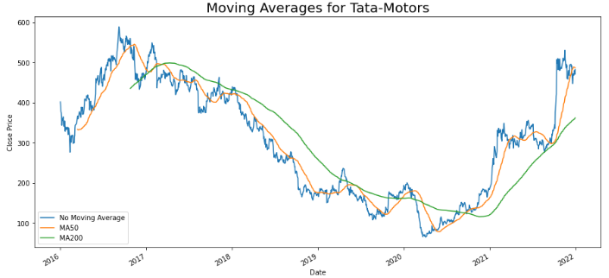
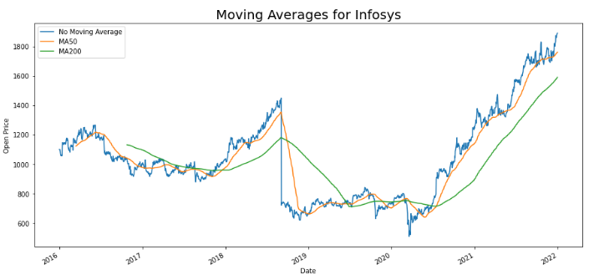
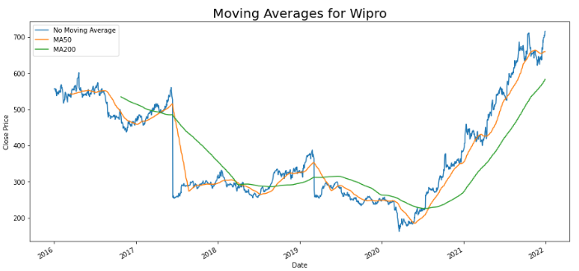
Moving Averages "*For All Stocks"
Since the initial Line plots were Not much Useful except the Total Traded visuals, So, we will do Moving Averages to get proper insights, Calculated and plotted MA50 and MA200.
18

Slide 19
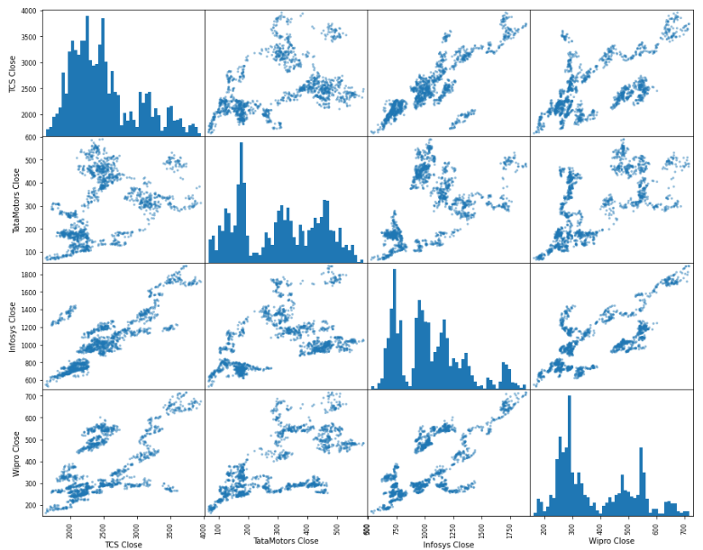
Correlation & Scatter Matrix of "Close Stock"
Relations between the Stocks/ Might there be dependency, of the initial Line Plot that exixt
and every stock is related to Information Technology Service Providing Companies
#Extracted only all the "Open" Stock Prices of all 4 Stocks
looking at correlation between random variables you can view stock prices as random variables this is what it is
scatter matrices determine if you have a linear correlation between one or more variables.
We can see there is a sort of Positive Correlation between TCS Close and Infosys Close ; and Wipro with Infosys;
19

Slide 20
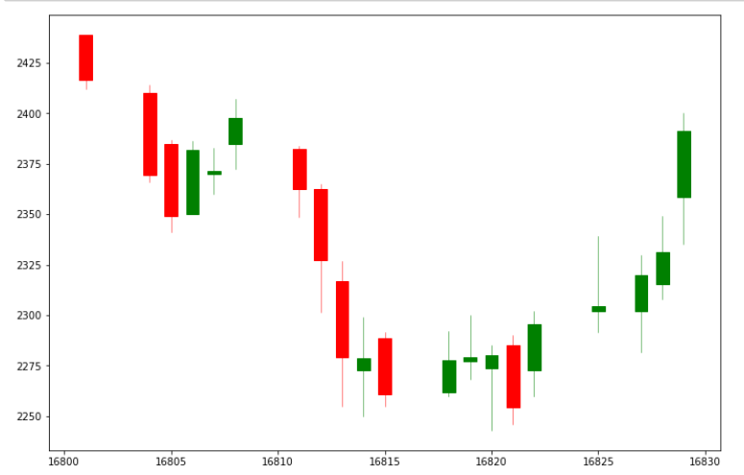
Candlestick Charts: In “TCS” stock
Candlestick charts are popular in stock market analysis.
They are helpful in understanding the past stock movements.
Candlestick charts give us insights into stock’s open, close, high, low prices.
Green candlesticks show positive movement and red shows a decline in the stock.
Library used: mpl_finance
20

Slide 21
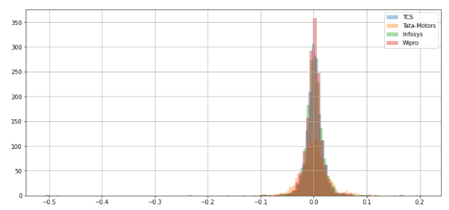
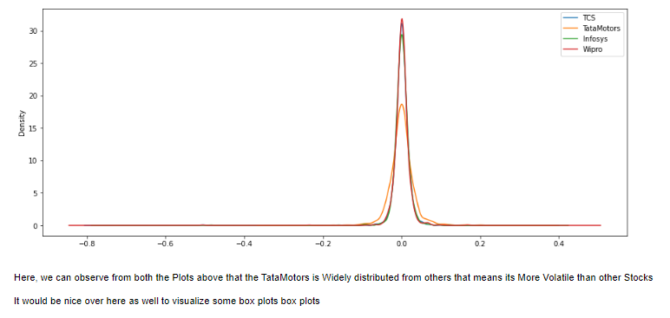
Financial analysis topic: Daily Percentage Change "'Returns’
To predict future values of the stock its very helpful and analyzing the so called volatility of the stock.
so lets say if your daily returns have a wide distribution the stock is more volatile
We Need to Invest in a Stock that is STABLE on long run and low risk and there should be ‘No Volatility’
It is given by: Rt = (Pt / Pt - 1)-1
Where, Rt is return at time t; Pt is Price at Time t
So, this value reports is a percentage gain or even loss Lets say you bought the stock on (Pt-1)day t minus 1 and then you sold it at Day(Pt) okay then if you gain then PT should be greater than PT minus 1 -> then if you gain then Pt should be greater than Pt minus 1 so this ratio should be greater than 1 and hence Rt would be positive
Density Plot
Histogram
The width of this bell shape is related to the standard deviation of the distribution, so higher it is the more variance.
We know that the variance of a certain distribution is directly related to the standard deviation
So, the higher the standard deviation is the higher the variance is so the more volatility we have in terms of stock analysis
21

Slide 22
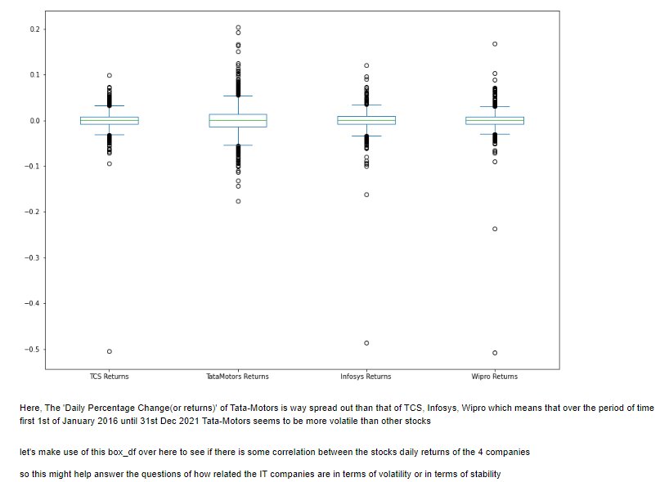
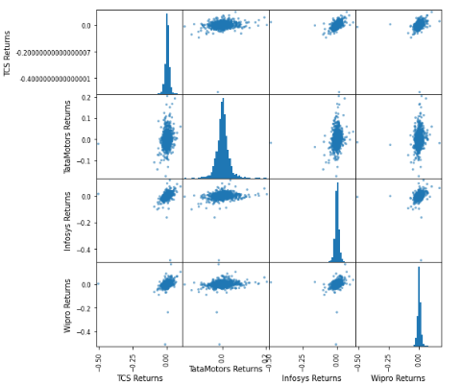
BOXPLOTS and SCATTER-Matrix of All Stocks for “returns”
22

Slide 23
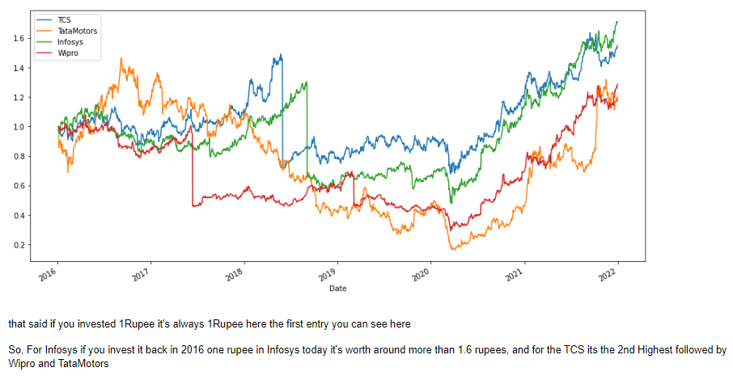
Cumulative Return: Given by : It = (1 + Rt)*It-1 We know that Rt = (Pt / Pt - 1)-1 So : It = (Pt / Pt -1)*It-1
Cumulative Returns are computed relative to the day investment has been made. If cumulative return is above 1 for all dates over here then you are making profits else you're losing so let's try to compute cumulative returns for the 4 companies.
23

Slide 24
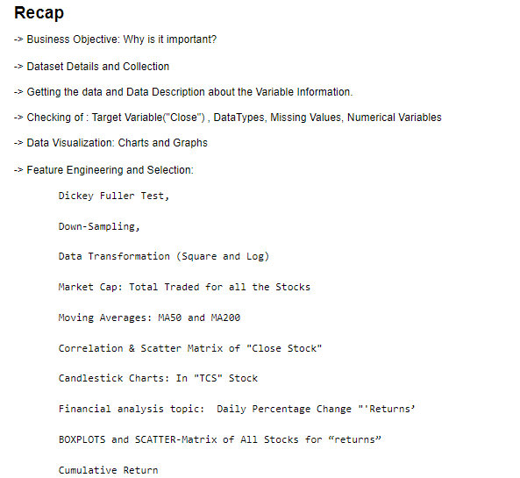
24

Slide 25
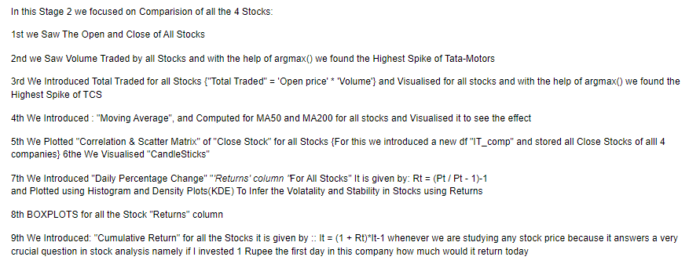
25

Slide 26
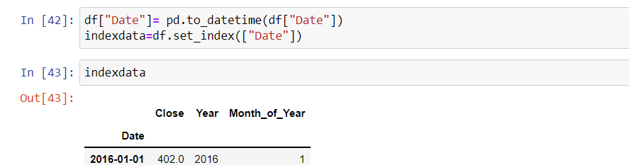
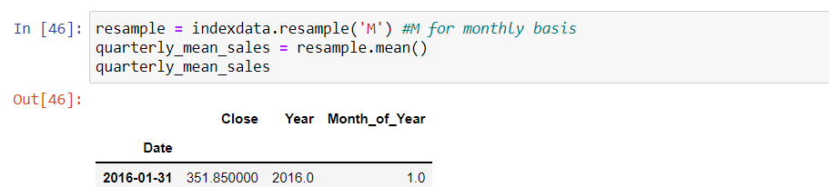
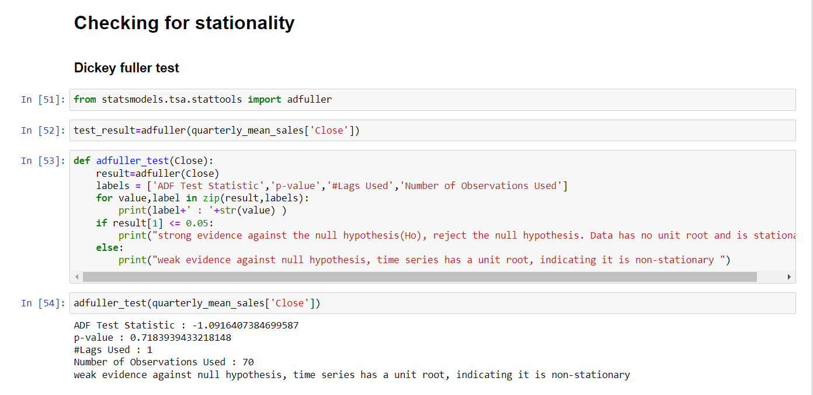
DickeyFuller Test (Converting from Non-Stationarity to Stationarity)
26

Slide 27
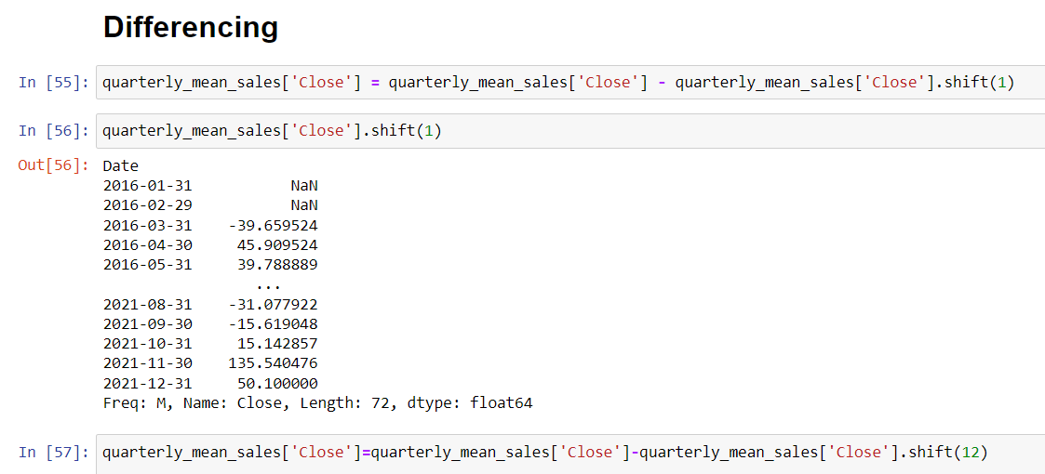
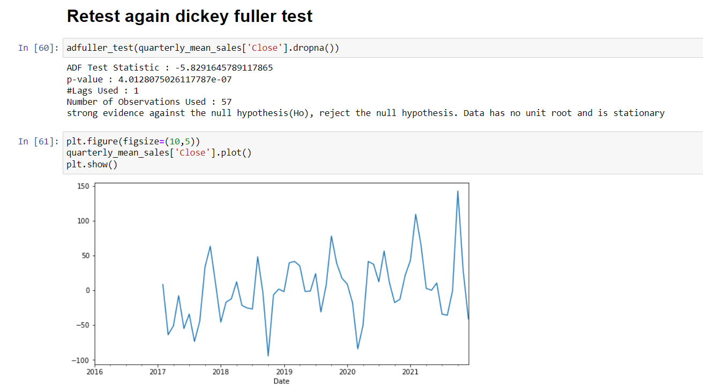

Slide 28
Model Building
In this project, We investigate the usage of different models to predict the Tata-Motors price
Time Series Models
Linear
Exponential
Quadratic
Additive seasonality
Additive seasonality with quadratic trend
Multiplicative seasonality
Multiplicative with additive seasonality
ARIMA
28

Slide 29
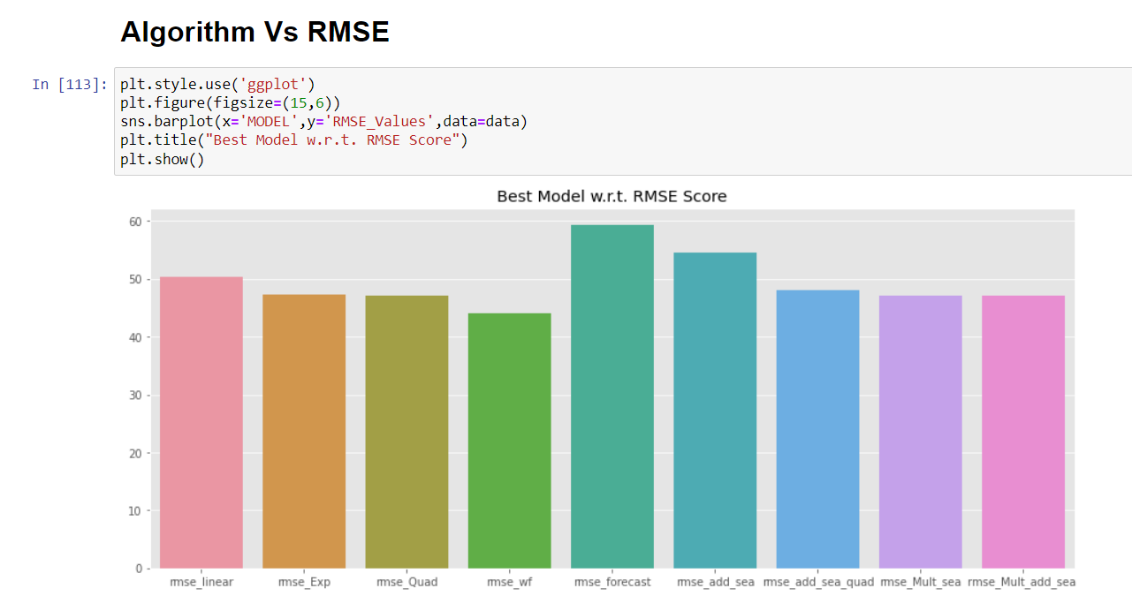
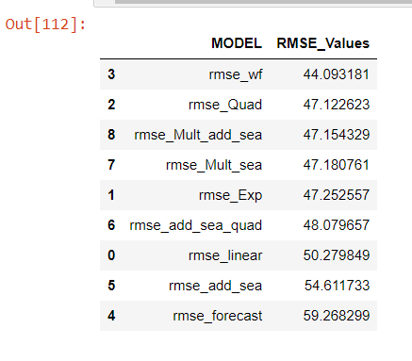
29

Slide 30
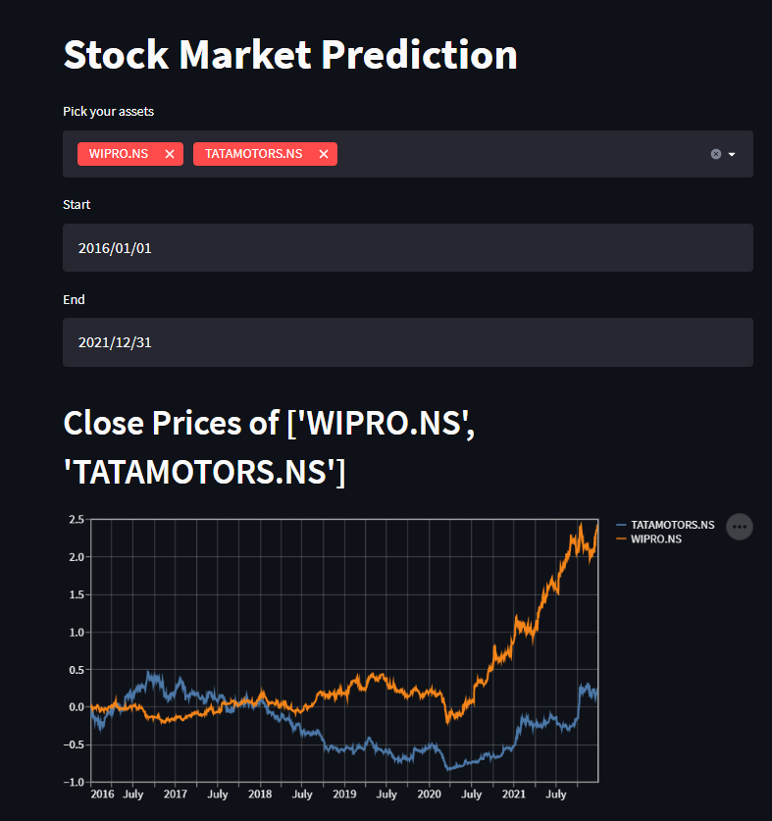
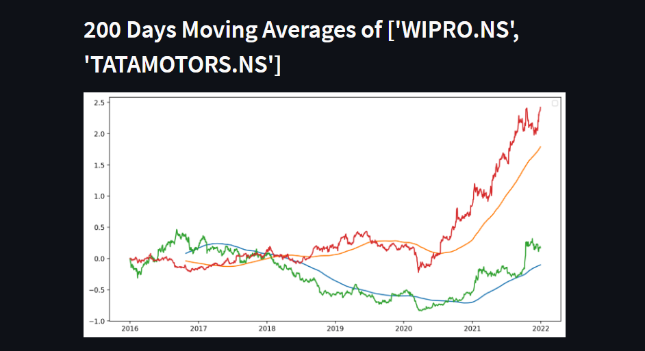
Deployment:
30

Slide 31
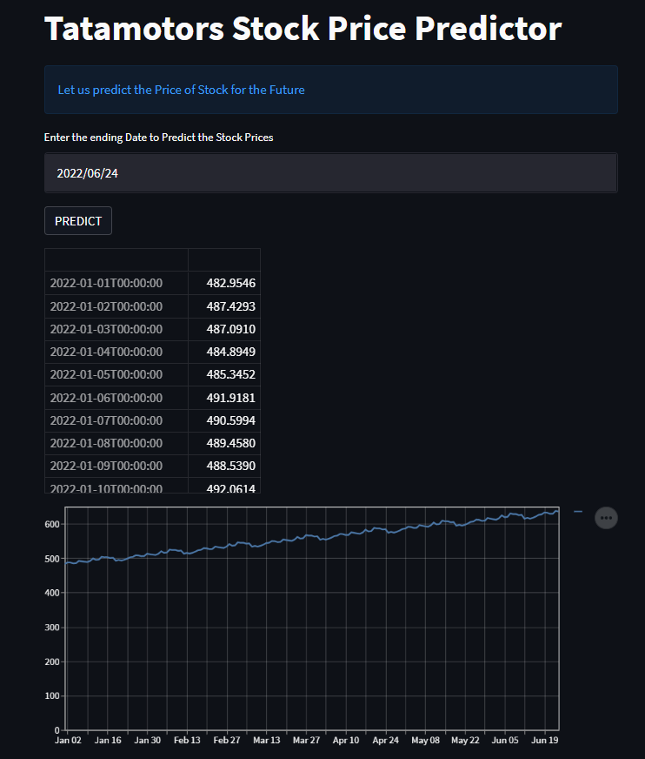
Prediction of Tatamotors for Next “n” Days
31
31

Slide 32
Challenges Faced:
Regarding the dataset, we were not sure which column to take as a target variable. After research, we collected ‘Close’ as the target column.
2. Considering the dataset, we were not sure to remove the Outliers in the Time-Series dataset.
We can think time series data like a chain since it learns from its own past. So, dropping random observations even if they have many missing data can break the chain or simply changes it.
When we run other algorithms than time series models, like regression, decision trees etc. it's okay to drop them since order of observations are not important.
However, in time series, order is very important and changing the order (or dropping observations) changes the dataset completely.
So, instead of dropping observations one by one,
it's more accurate to drop chain parts if necessary. e.g if observations, in some certain period of time from the start of the series, have lots of missing data,
we can consider dropping all the observations in that period, in order not to break the series.
32

Slide 33


Thank You
Saikiran Dasari and team
saikirandasari41@gmail.com

